Slide 1


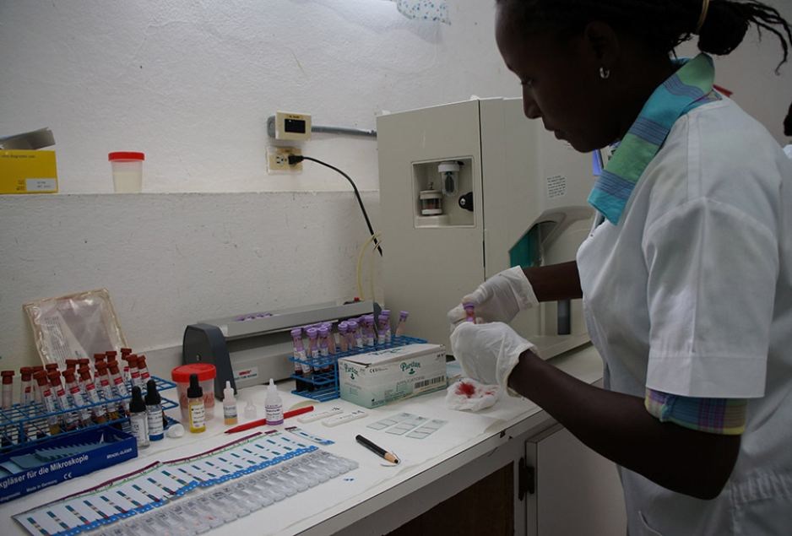
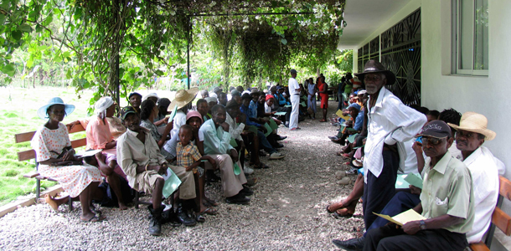

Second-line dolutegravir or protease inhibitor for adults with HIV in rural Haiti with virologic failure on a first-line NNRTI-based regimen without available genotype.
G. Constant¹, A. Richterman^{2, 3}, R. Blondel Charles¹, J. Bernard¹, F. Edmond¹, A. Beckett⁴, F. Leandre¹
¹Zanmi Lasante, Croix-des-Bouquets, Haiti, ²Brigham and Women's Hospital, Infectious Diseases, Boston, United States, ³Massachusetts General Hospital, Center for Global Health, Boston, United States, ⁴Partners In Health, Boston, United States
Background
Results
In patients experiencing virologic failure on first-line NNRTI-based regimens, changing to dolutegravir is non-inferior to lopinavir/ritonavir (both with two NRTIs) if one of the NRTIs is known to be fully active.¹
While boosted PIs combined with NRTIs have been shown to effectively suppress HIV even with no predicted NRTI activity, it is unknown whether this is the case for dolutegravir. Because of this, the optimal second-line ART strategy is unknown for patients failing first-line ART in settings where genotype is unavailable.
Partners In Health is a global health organization that works within governments’ public health infrastructure to support a full continuum of care for over 35,000 people living with HIV in Haiti, Malawi, Lesotho, Mexico, Rwanda, Peru, Sierra Leone, and Liberia. Zanmi Lasante, as Partners In Health is known in Haiti, provides comprehensive HIV treatment for over 12,000 people.
Haiti’s national protocols were updated in 2018 to include dolutegravir-containing regimens as the preferred first-line treatment option, and the preferred second-line treatment option for those patients failing non-dolutegravir-containing first-line ART. Routine genotyping is unavailable in Haiti.
378 patients were identified who changed ART after experiencing virologic failure on a first-line NNRTI from July 2015 through October 2019.
Characteristics of patients changed to 2nd line treatment (Table 1):
212 (56%) were female with a median age of 41 (IQR 30-50)
137 (33%) changed to dolutegravir
241 (64%) changed to a PI
96/137 (64%) changed to dolutegravir and 54/241 (22%) changed to a PI did not change NRTIs; among these 94% received TDF and 3TC
Only 4 patients (1%) were receiving tuberculosis treatment
Subsequent viral load testing was available for 279 patients (74%), and virologic suppression was achieved in:
40/65 (62%) of patients changed to dolutegravir, and
75/214 (35%) of patients changed a PI.
In our multivariable model, switching to dolutegravir was independently associated with subsequent virologic suppression with adjusted odds ratio of 2.91 (Table 2).
Age (per five year increase) was also independently associated with subsequent virologic suppression with adjusted odds ratio of 1.15.
Methods
We conducted a retrospective study of Haitian adults with HIV at 11 rural Ministry of Health clinics supported by Partners In Health / Zanmi Lasante who had virologic failure on a first-line NNRTI-based regimen and were changed to either dolutegravir or a PI with two NRTIs.
Demographic and clinical information were abstracted from the electronic record. A multivariable logistic regression model was used to identify factors associated with subsequent virologic suppression.
Conclusions
Our experience suggests that for patients experiencing virologic failure on a first-line NNRTI without an available genotype, changing to dolutegravir is a superior strategy compared to changing to a PI, even if NRTIs are not changed.
This study is limited by differential subsequent viral load testing available between dolutegravir and PIs.
Dieuline Louis tests blood samples for HIV clinic in Boucan Carre, Haiti.
References
1. Aboud, Michael, et al. "Dolutegravir versus ritonavir-boosted lopinavir both with dual nucleoside reverse transcriptase inhibitor therapy in adults with HIV-1 infection in whom first-line therapy has failed (DAWNING): an open-label, non-inferiority, phase 3b trial." The Lancet Infectious Diseases 19.3 (2019): 253-264.
Patients waiting outside a Partners In Health / Zanmi Lasante HIV clinic in central Haiti.
PRESENTED AT THE 23RD INTERNATIONAL AIDS CONFERENCE (AIDS 2020) | 6-10 JULY 2020

